Slide 1

AUTOMOBILE SALES PERFORMANCE ANALYSIS
PRESENTED BY,
FARZANA P A

Slide 2
INTRODUCTION
Auto sales industry generates a large volume of data including sales transactions, customer details, and product information.
Analyzing this data manually is complex and time-consuming.
Data visualization tools like Tableau help convert raw data into meaningful insights.
This project focuses on analyzing auto sales performance using an interactive dashboard

Slide 3
PROJECT OBJECTIVES
To analyze overall sales and profit performance
To identify top-performing product categories
To recognize high-value stores
To study sales trends over time
To build an interactive and user-friendly dashboard
To support better business decision-making

Slide 4
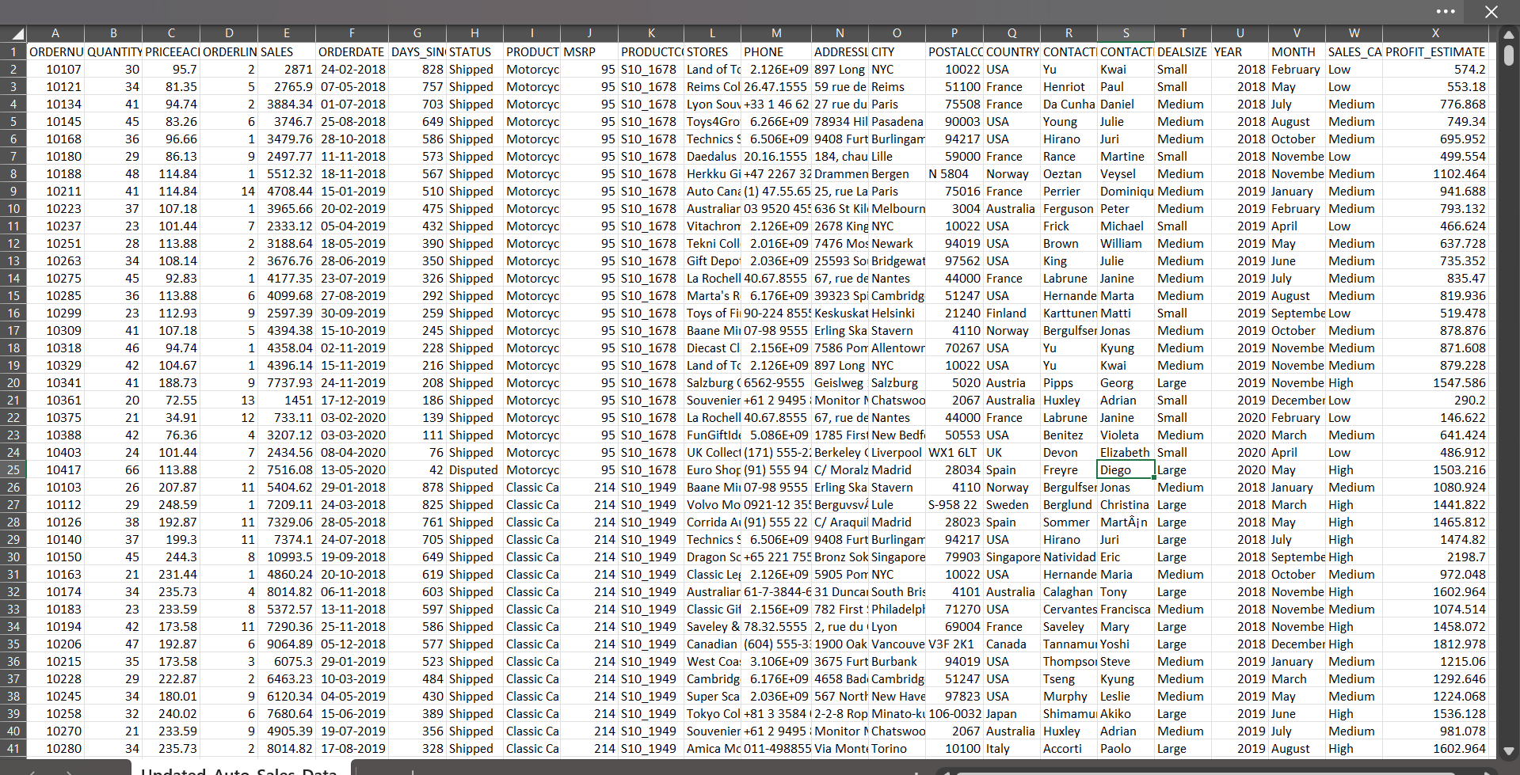
DATASET USED

Slide 5
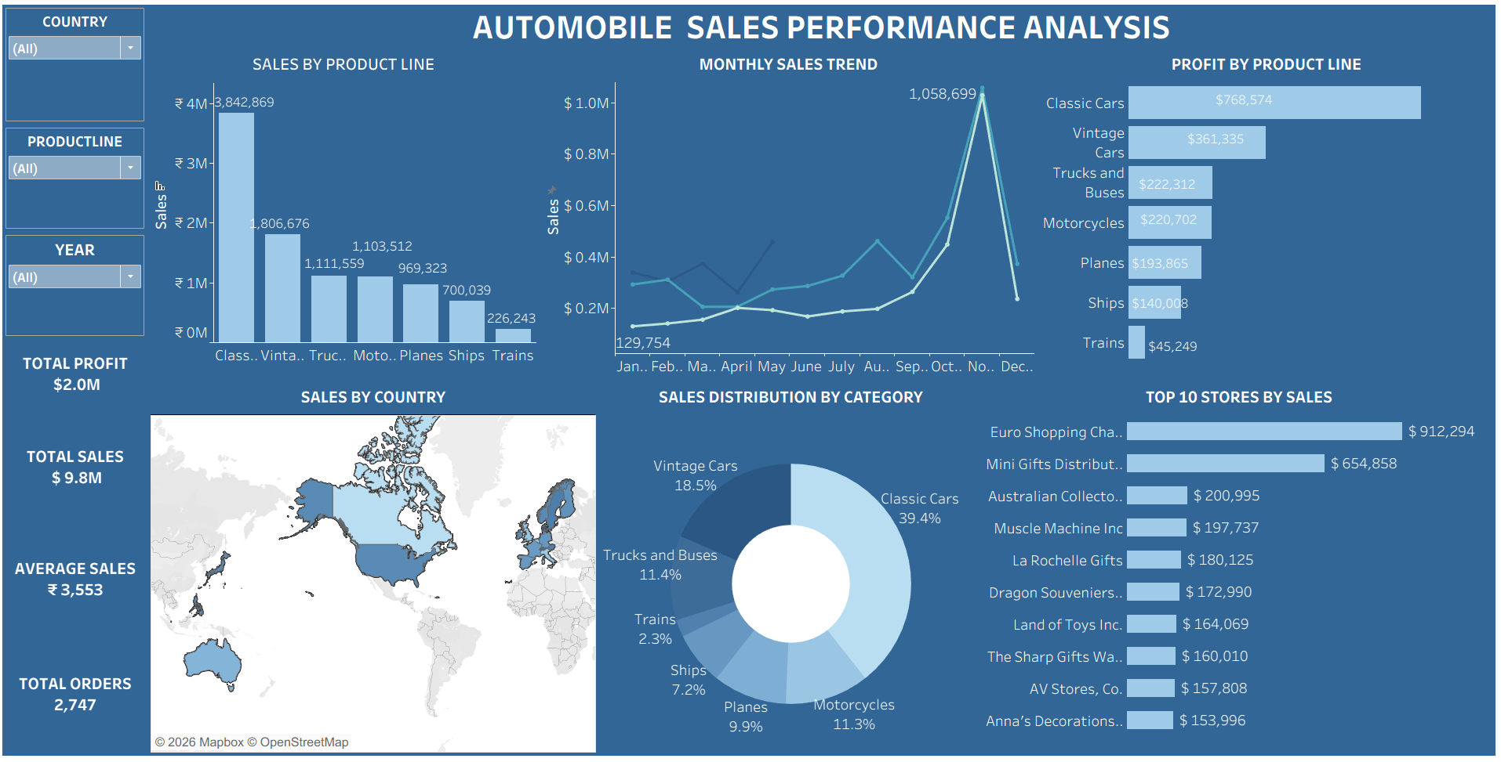
DASHBOARD

Slide 6
CRITERIA USED IN THIS PROJECT
Data Selection Criteria
Relevant auto sales dataset selected
Contains sales, profit, store, and product details
Sufficient number of records for analysis
Data Cleaning Criteria
Removed missing and null values
Corrected inconsistent data entries
Standardized formats (currency, date, etc.)
KPI Selection Criteria
Total Sales → to measure revenue
Total Profit → to evaluate business success
Total Orders → to track performance volume

Slide 7
Visualization Criteria
Bar Chart → for product comparison
Line Chart → for trend analysis
Donut Chart → for percentage distribution
Map → for geographical insights
Horizontal Bar → for top stores
Filter Criteria
Year → to analyze time-based trends
Product Line → to compare categories
Country → for regional analysis
Insight Generation Criteria
Identify top-performing products
Analyze high-revenue regions
Understand customer behavior patterns

Slide 8
CONCLUSION
The dashboard effectively visualizes auto sales performance
Key metrics like sales, profit, and orders are clearly presented
Helps in identifying top products and stores
Provides insights into regional (country-wise) performance
Interactive filters improve data exploration
Supports better and faster business decision-making

Slide 9
SUGGESTIONS
Focus on high-performing product categories
Improve marketing in low-performing regions
Target high-value stores
Use data-driven strategies for growth

Slide 10
THANK YOU

